Slide 1
Toronto Bicycle Thefts Data Analysis
DAMG 7370

Slide 2
Team
Chaitanya Sai Gandi
Cloud Infra & ETL
EC2, Kafka, S3, Python ETL
Mudra Pandya
Data Modeling & SQL
RDS schema, SQL queries & views
Qi Han
BI & Dashboards
QuickSight visuals & storytelling

Slide 3
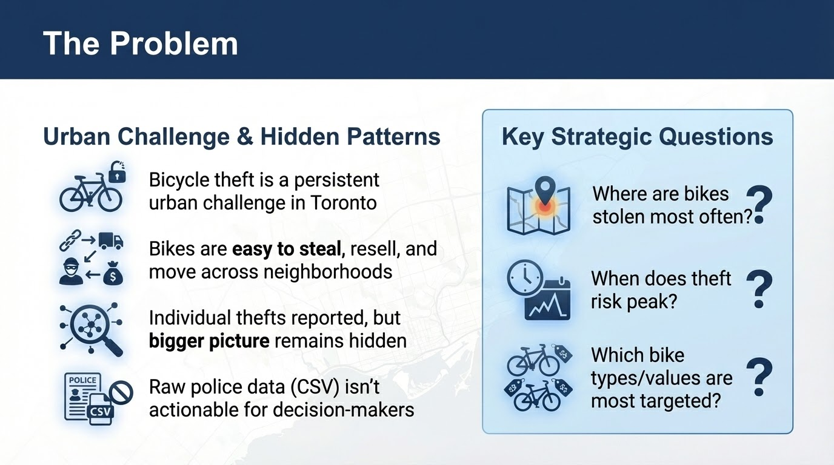

Slide 4
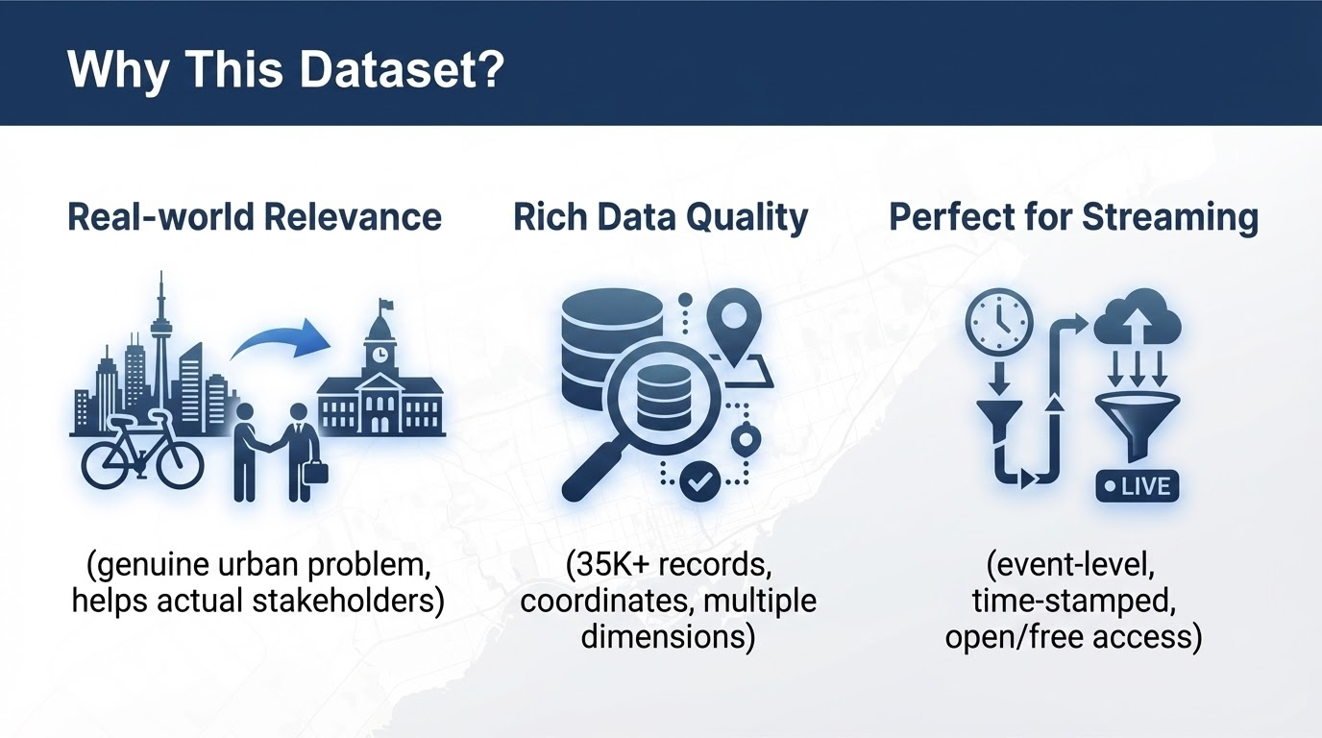

Slide 5
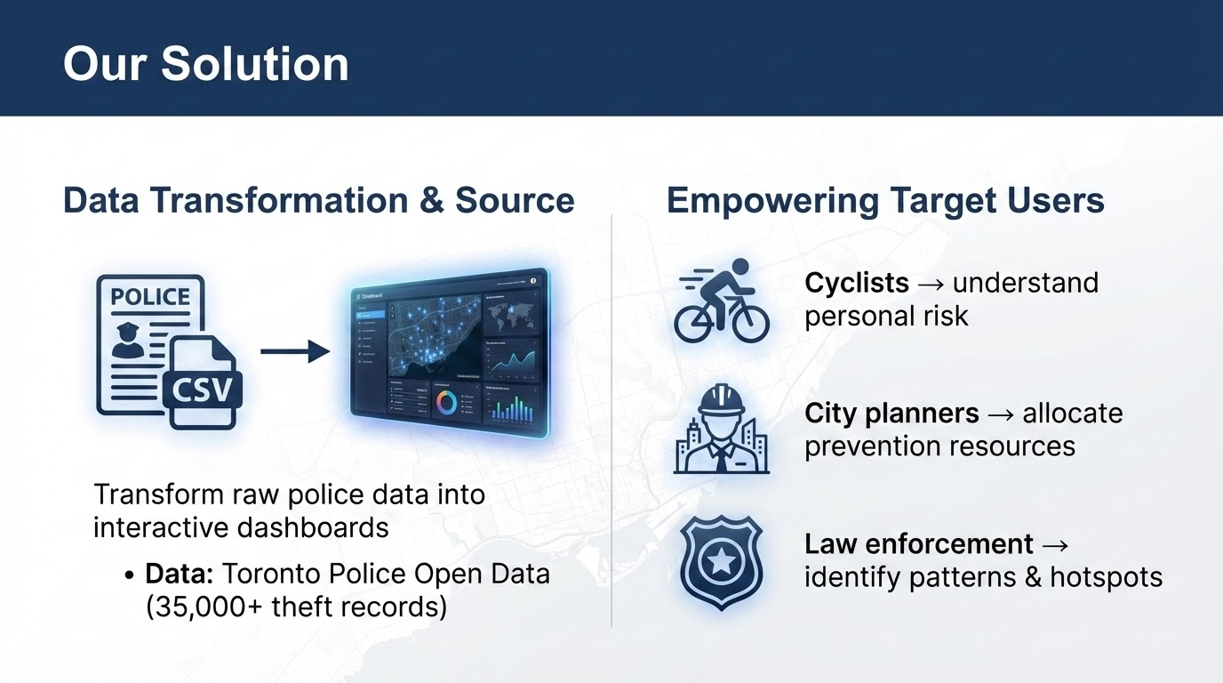

Slide 6
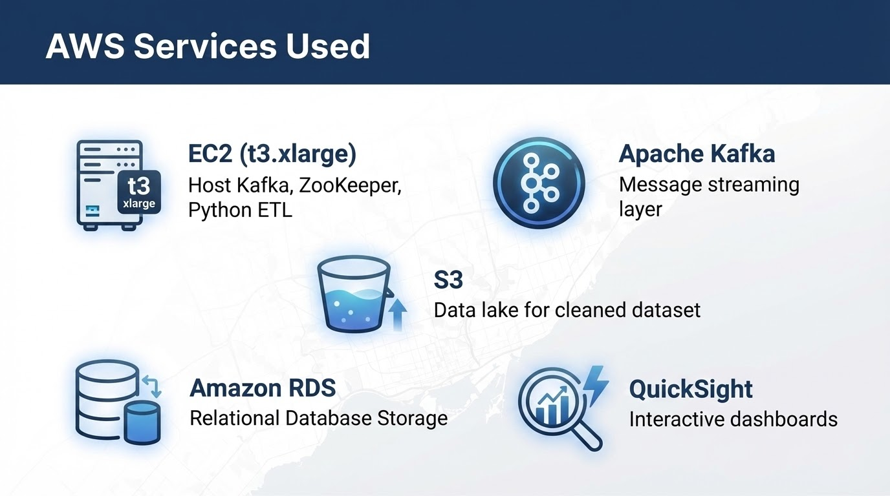

Slide 7
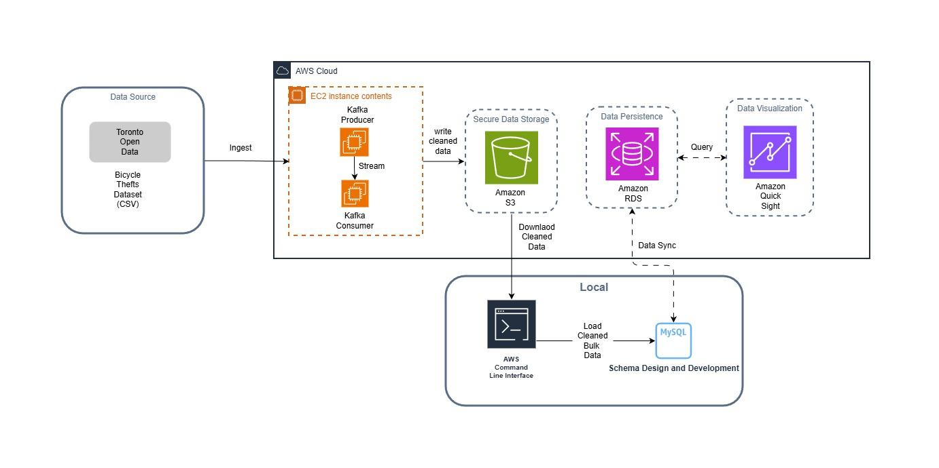
Architecture Overview

Slide 8
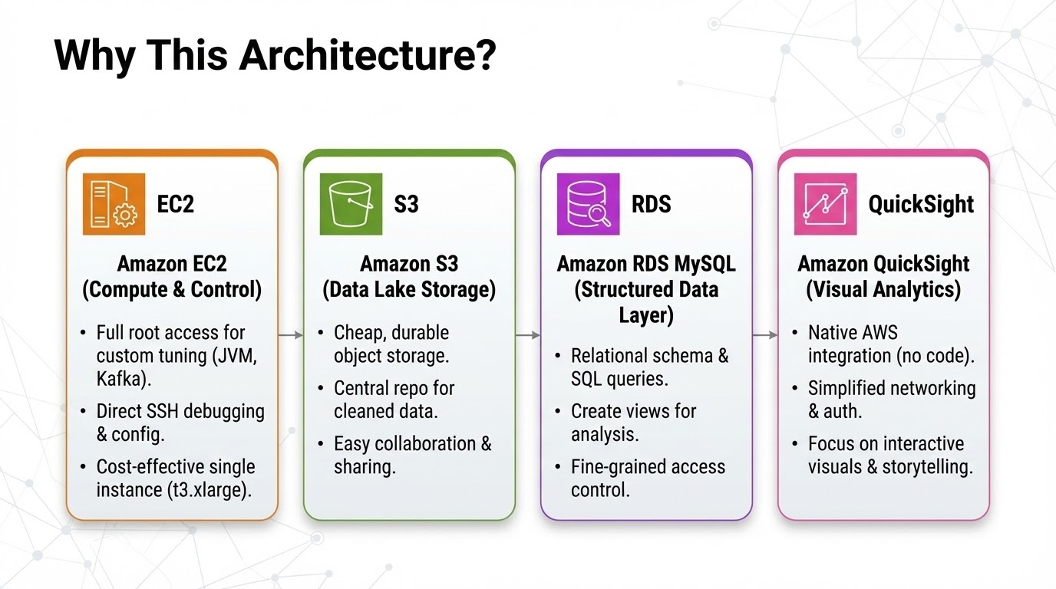
Notes:
we use EC2 as a full Linux VM where we can install and control everything ourselves—Java, Kafka, ZooKeeper and the Python ETL—so we can tune configs and debug over SSH on a single t3.xlarge box. S3 is the cheapest and most durable place to park our cleaned CSV, and it makes sharing the same dataset with teammates and other jobs really easy. RDS MySQL gives us a managed relational database, so we don’t worry about patching or backups but still get proper SQL, schemas, and views for analysis. And QuickSight is a native BI tool on AWS that plugs straight into RDS, so we can build interactive dashboards, maps, and filters without building our own front-end or managing another analytics tool.

Slide 9
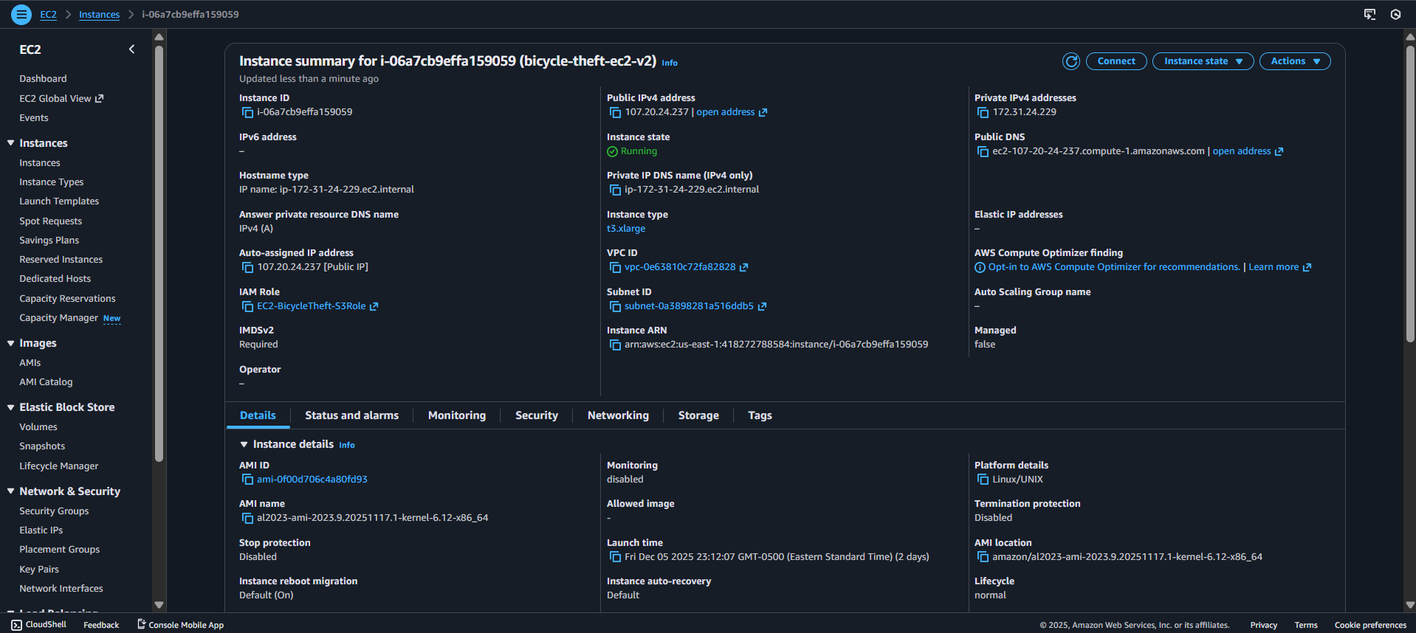
This screenshot shows the EC2 instance (bicycle-theft-ec2-v2) that hosts our data processing stack. It is a t3.xlarge instance in us-east-1 with public IP 107.20.24.237 and IAM role EC2-BicycleTheft-S3Role. On this machine we installed Java, Kafka, ZooKeeper and Python, and we run the Kafka producer and consumer ETL scripts that read the raw bicycle theft CSV, stream it through Kafka, clean it with pandas, and upload the cleaned dataset to S3.

Slide 10
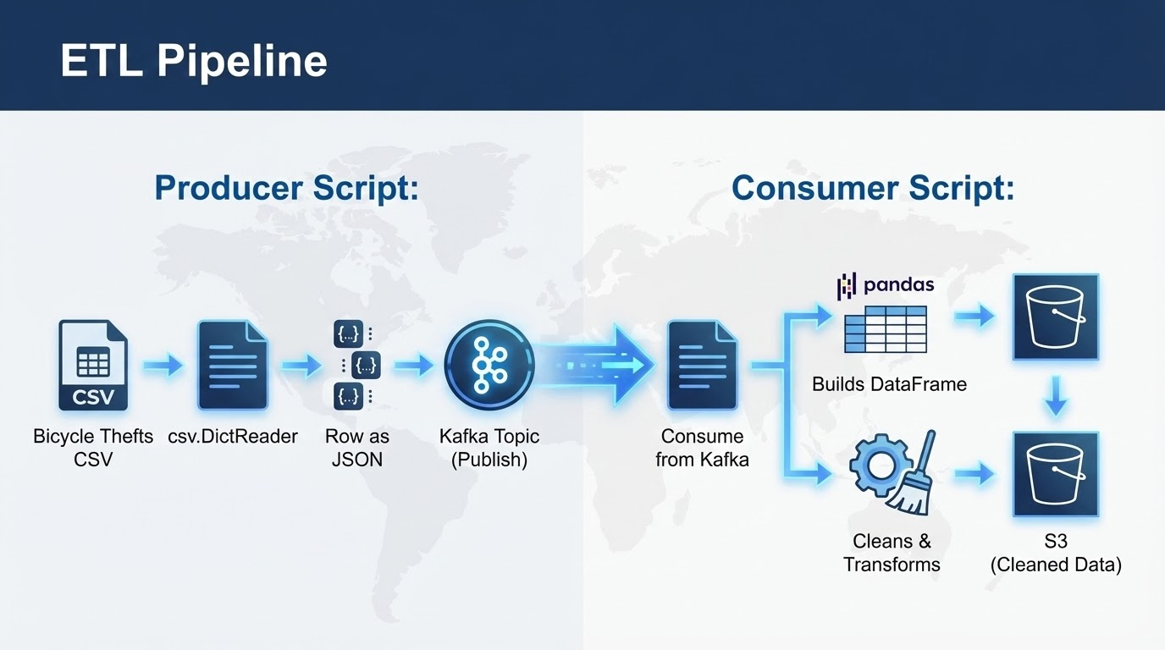

Slide 11
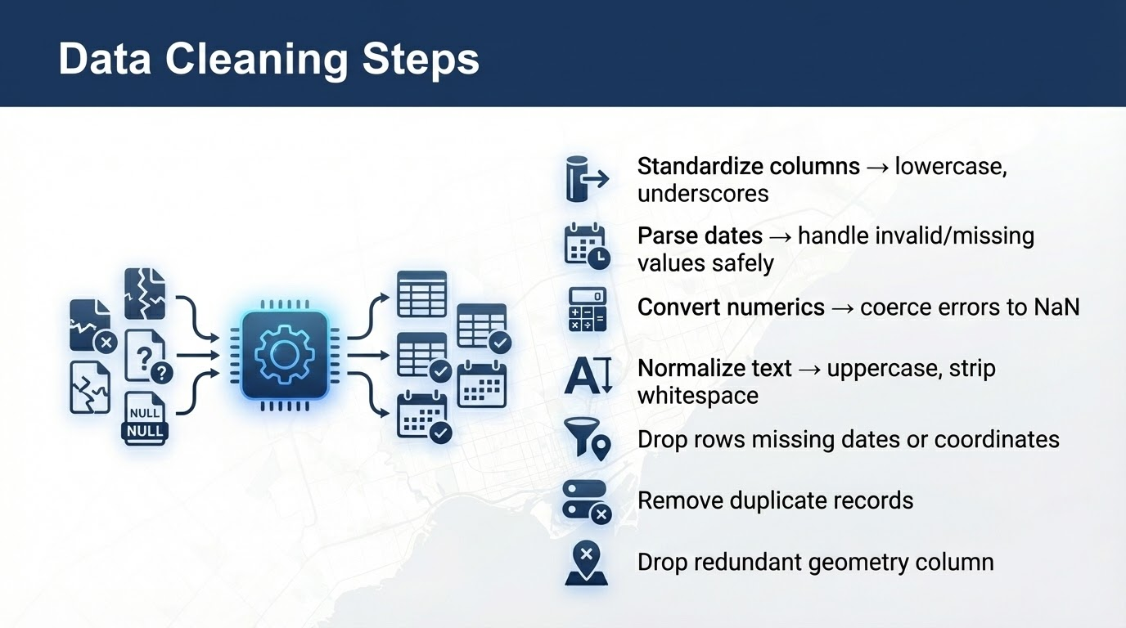

Slide 12
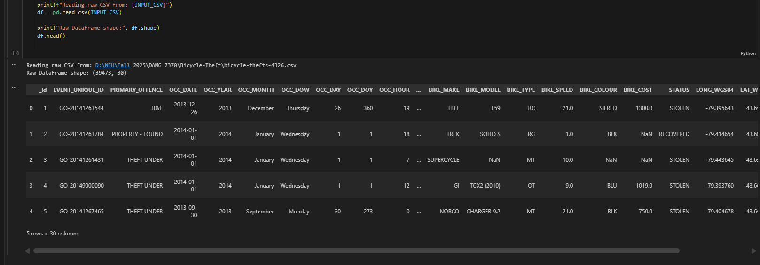
Raw Toronto Bicycle Thefts dataset loaded in pandas
This cell shows the initial load of the bicycle-thefts-4326.csv file into a pandas DataFrame. The raw dataset has 39,473 rows and 30 columns, including event details, dates, location context, bike attributes and geospatial fields. At this stage we can already see issues such as mixed data types and missing values in fields like BIKE_TYPE and BIKE_COST, which motivates the subsequent cleaning and standardization steps in our ETL pipeline.

Slide 13
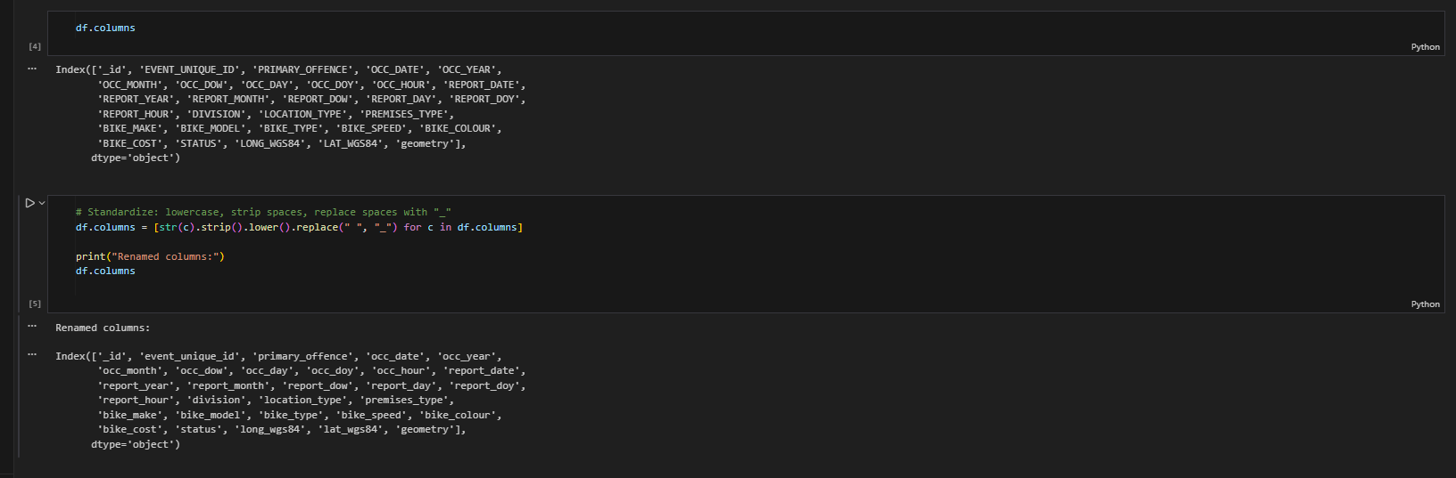
Standardizing column names for consistent downstream processing
In this step I inspect the original column names from the raw CSV and then standardize them by converting everything to lowercase, stripping extra spaces, and replacing spaces with underscores (e.g., OCC_DATE → occ_date, REPORT_YEAR → report_year). Having clean, consistent column names makes it much easier to write SQL, build views in MySQL, and reference fields later in the Kafka ETL code and QuickSight dashboards.

Slide 14
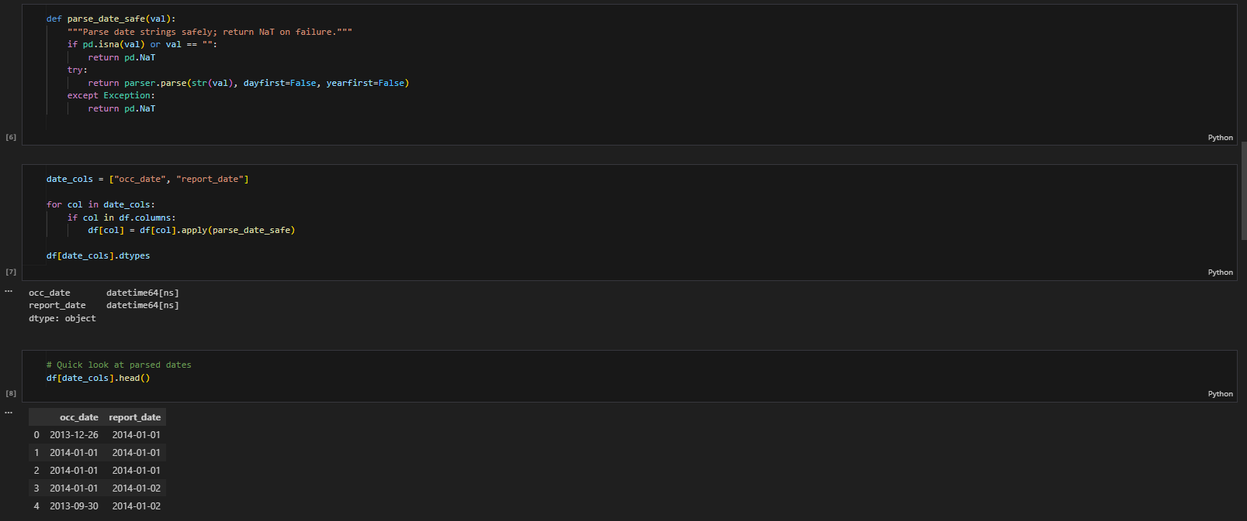
Converting raw date strings into proper datetime fields
Here I define a helper function parse_date_safe that safely converts raw date strings into pandas datetime objects and returns NaT for any invalid or missing values. I then apply this function to the two key date columns, occ_date and report_date. The output shows that both columns are now stored as datetime64 and the preview confirms that the dates are parsed correctly, which is important for doing time-series analysis (by year, month, day, or hour) later in SQL and QuickSight.

Slide 15
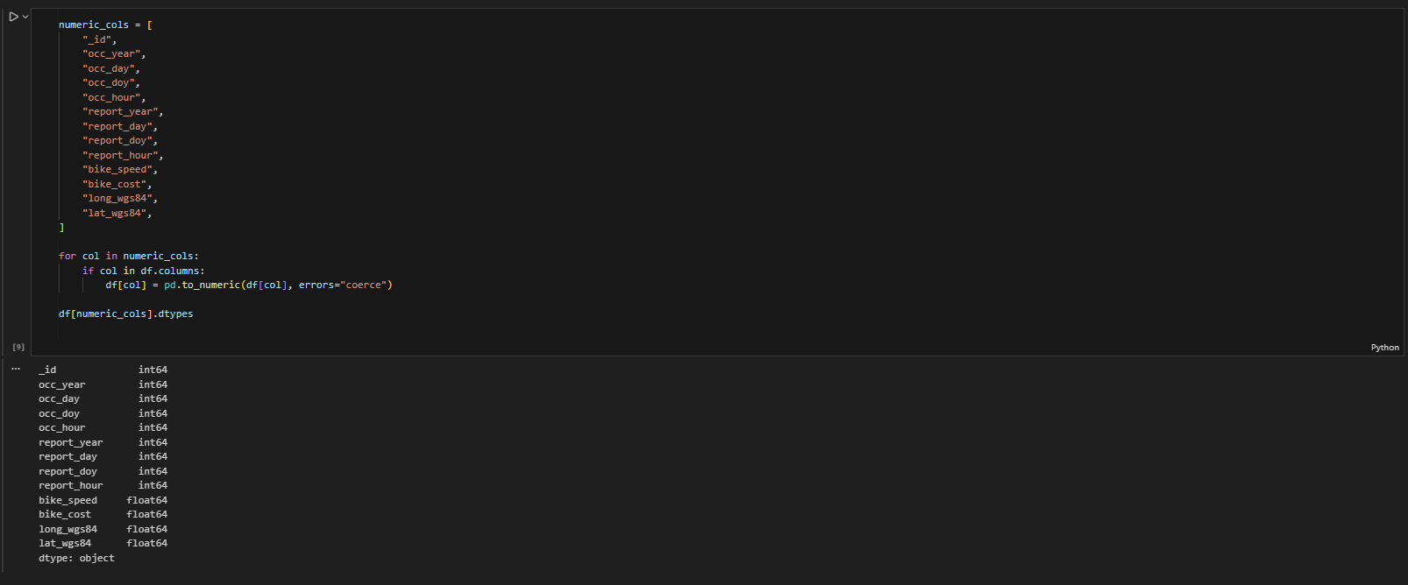
Converting key fields to numeric types
In this step I define a list of columns that should contain numeric values (years, day-of-week indexes, hours, bike speed/cost, and latitude/longitude). I then loop through this list and use pd.to_numeric(..., errors="coerce") to force each column into a numeric type, converting any invalid values to NaN. The dtype summary at the bottom confirms that these fields are now stored as int64 or float64, which is required for reliable aggregations, statistics, and mapping in MySQL and QuickSight.

Slide 16
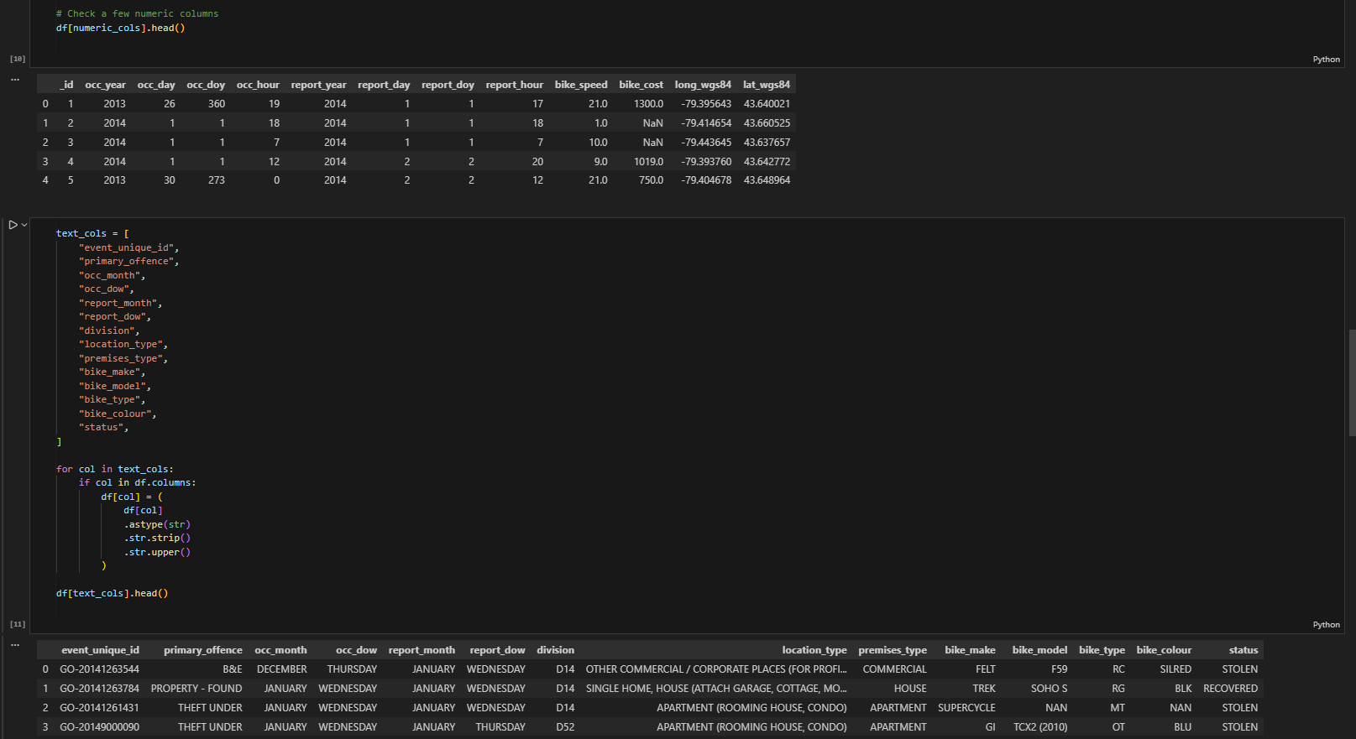
Standardizing text columns for consistent analysis
Here I define a list of all categorical/text columns (offence details, dates as words, division, location and premises type, bike make/model/type/colour, and status). For each of these columns I convert the values to string, strip extra spaces, and convert everything to uppercase. The preview at the bottom shows the cleaned text (e.g., months and days in uppercase and without trailing spaces). This makes grouping, filtering, and joining in MySQL and QuickSight much more reliable and avoids issues caused by inconsistent spelling or casing.

Slide 17
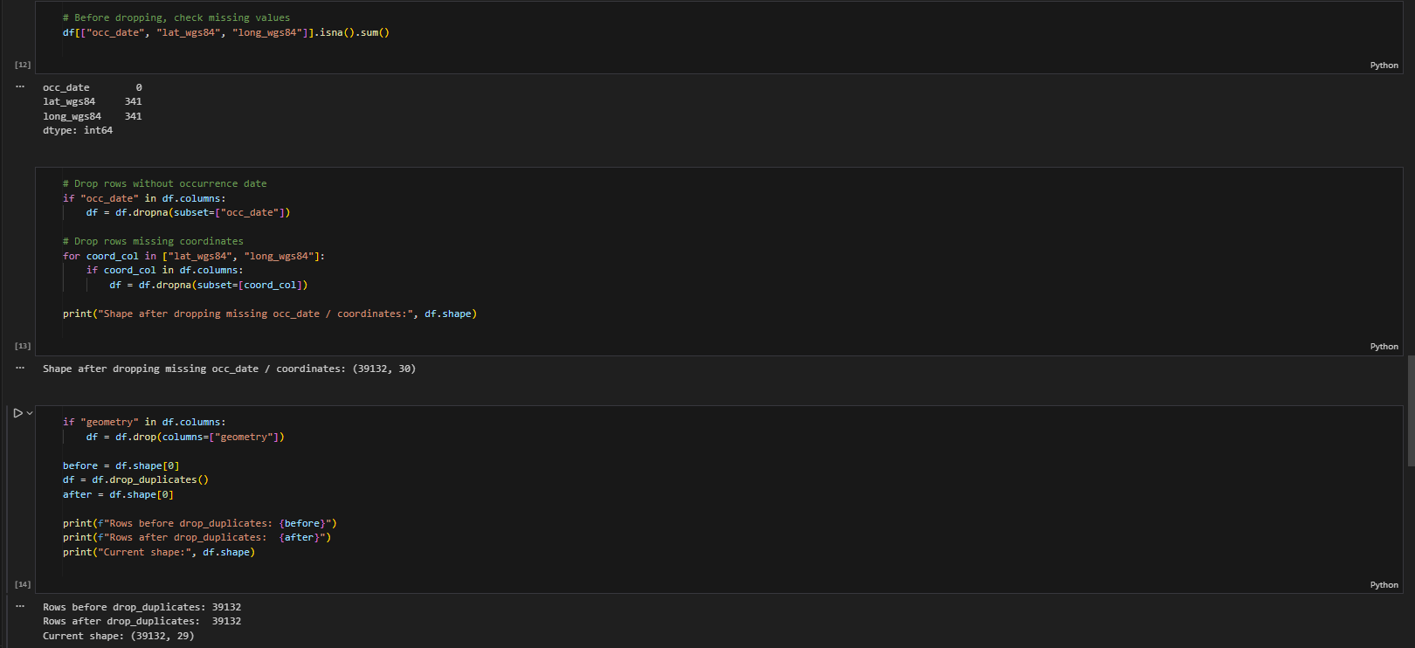
Removing rows with missing key fields and duplicates
In this step I first check how many missing values we have in the critical columns occ_date, lat_wgs84, and long_wgs84. Then I drop any rows that do not have an occurrence date or valid latitude/longitude, because those records cannot be used for time-based or map-based analysis. After that I remove the geometry column (it stores the same location in a complex JSON format, which we don’t need once we have clean lat/long) and call drop_duplicates() to ensure that duplicate incidents are not counted twice. The printout at the bottom shows how many rows remain and confirms the final cleaned shape of the dataset.

Slide 18
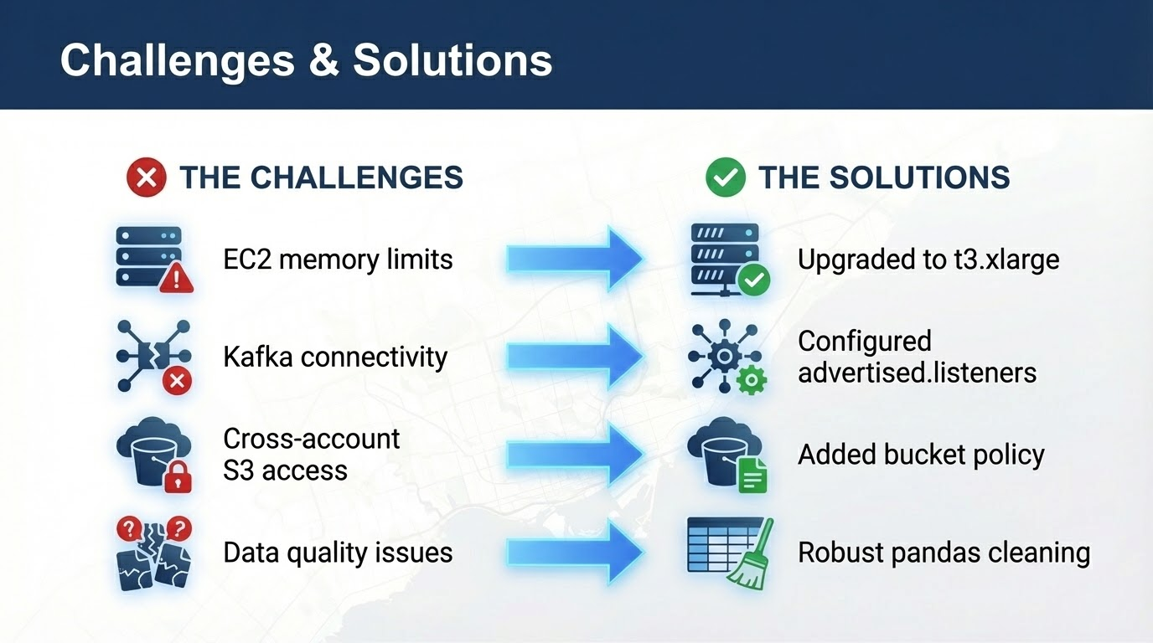

Slide 19
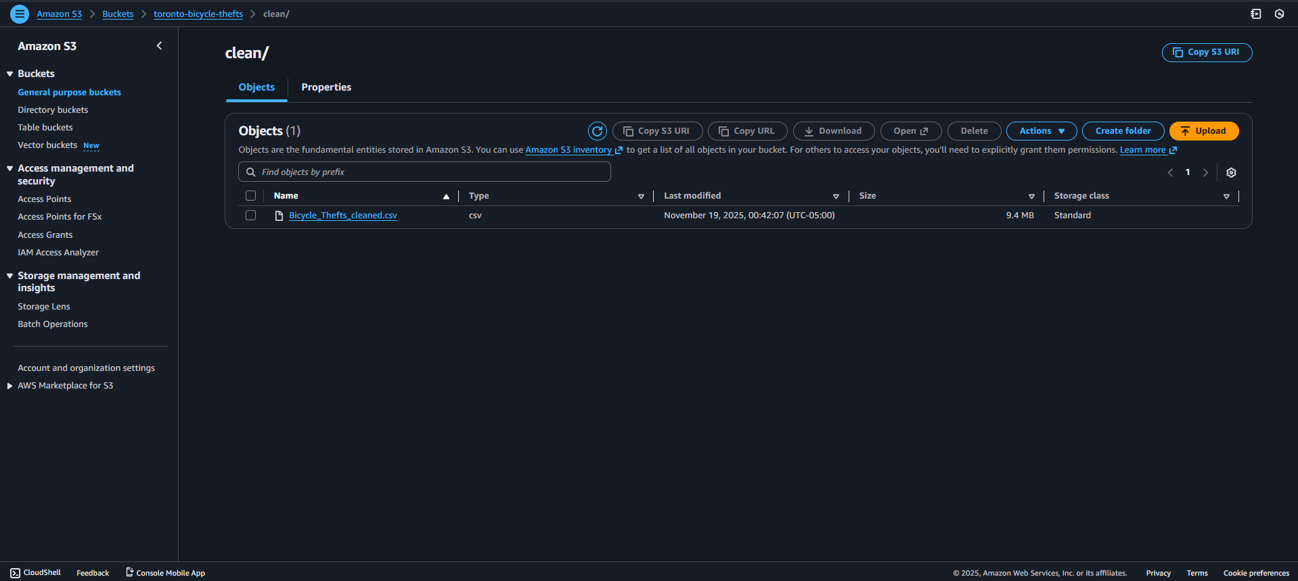
This screenshot shows the toronto-bicycle-thefts S3 bucket, specifically the clean/ prefix that contains the processed file Bicycle_Thefts_cleaned.csv. This object is the output of the Kafka consumer ETL job running on EC2. S3 acts as our data lake: the cleaned CSV in this location is shared with teammates (via bucket policy) so they can download it, load it into Amazon RDS MySQL, and use it as the source for SQL analysis and QuickSight dashboards.

Slide 20
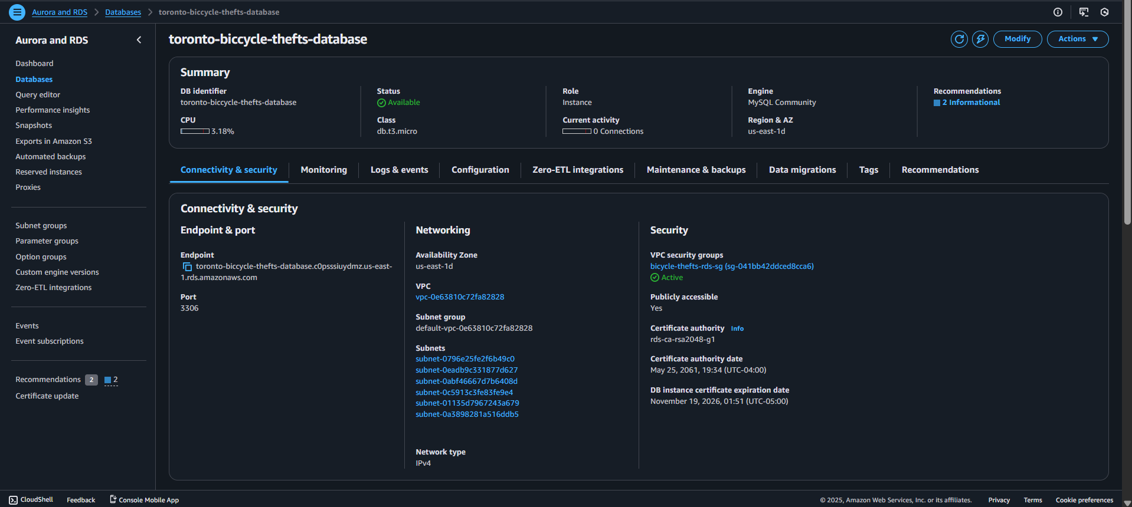
This screenshot shows the toronto-bicycle-thefts-database Amazon RDS instance that we use as the relational analytics layer. The engine is MySQL Community (db.t3.micro) running in us-east-1d, exposed on port 3306 with public access enabled so teammates can connect from MySQL Workbench and QuickSight. The endpoint shown here is used to load the cleaned CSV from S3 and create tables/views, and later used as the data source for building the Toronto bicycle theft dashboards.

Slide 21
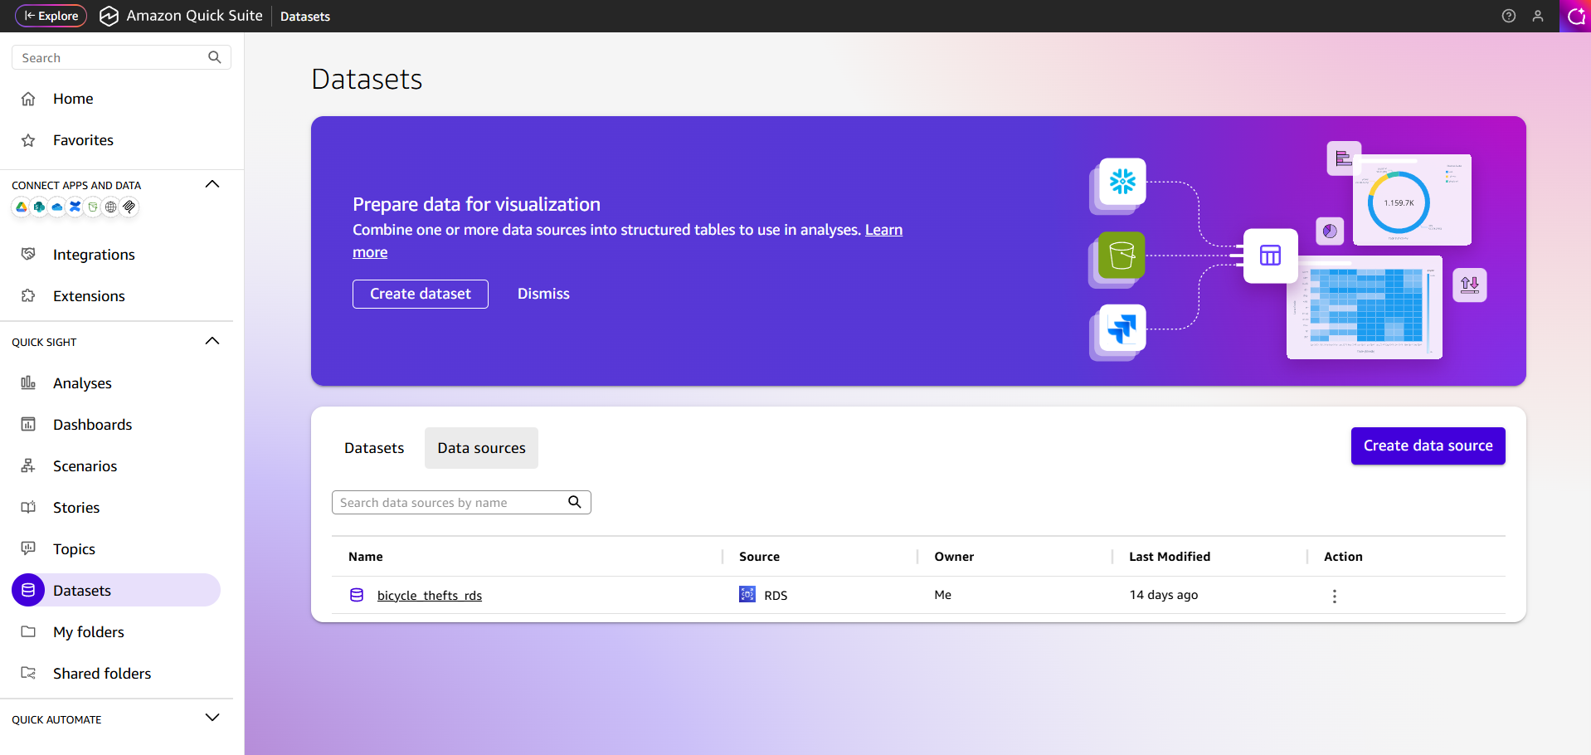
In this step, I created an Amazon QuickSight account to build the dashboards for our project and added a data source that points directly to our RDS MySQL instance. Because QuickSight is natively integrated with RDS, connecting the database and starting to design charts, maps, and filters was straightforward and required almost no extra setup.

Slide 22
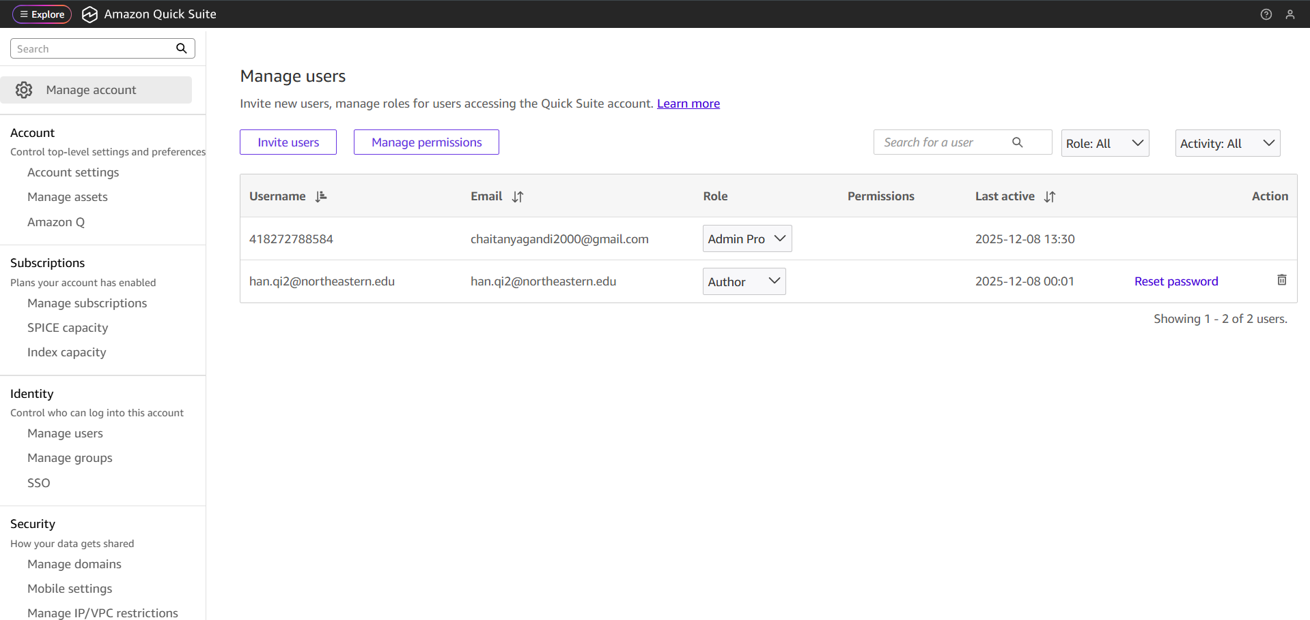
In QuickSight, I also configured access for my team. From Manage account → Manage users, I invited my teammate using their email and assigned them the Author role. This ensures they can log in, connect to the shared RDS data source, and independently build and edit the project dashboards while I keep admin control of the account.

Slide 23
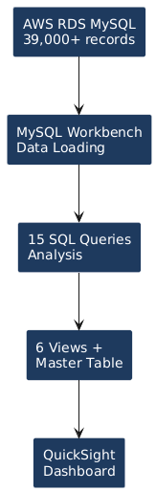
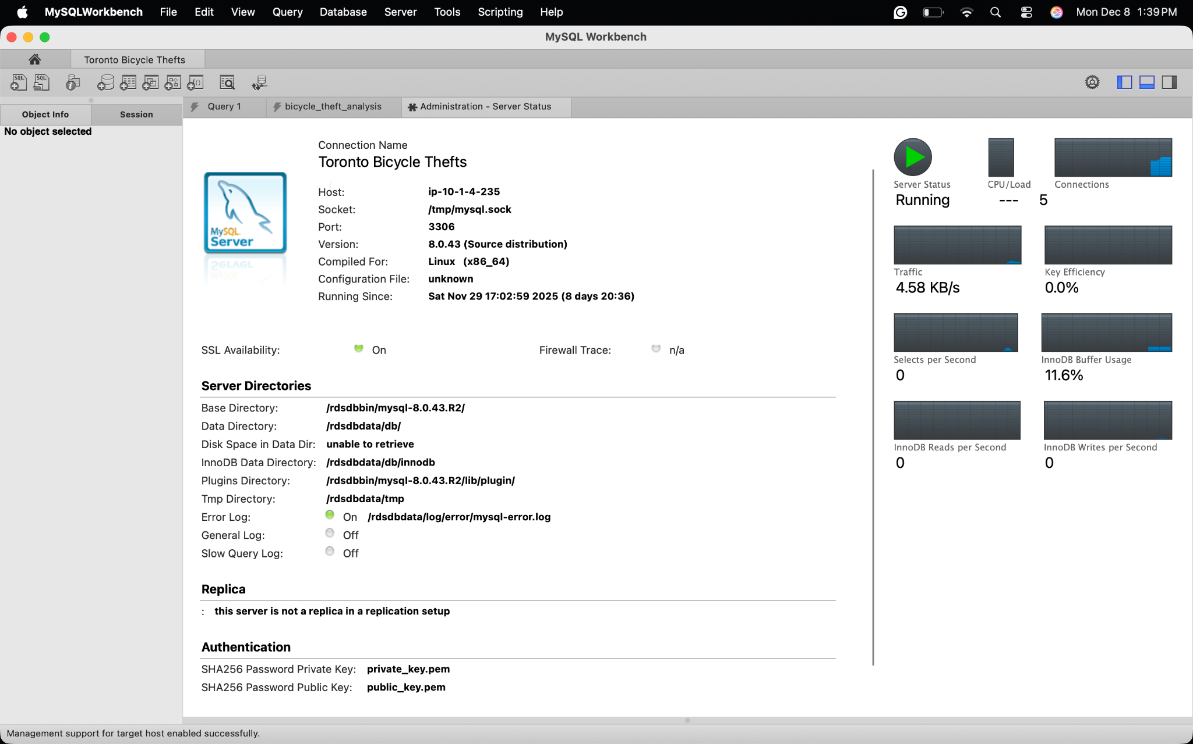
SQL Analysis & Database Design
Connected to AWS RDS MySQL database
Loaded 39,000+ bicycle theft records
Developed 15 analytical queries
Created 6 views + master table for dashboards

Slide 24
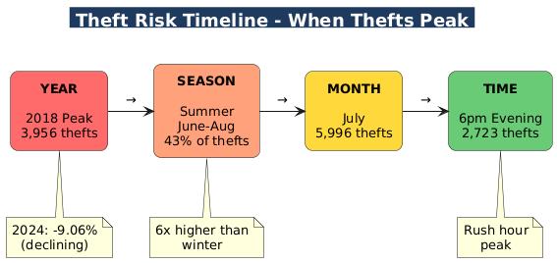
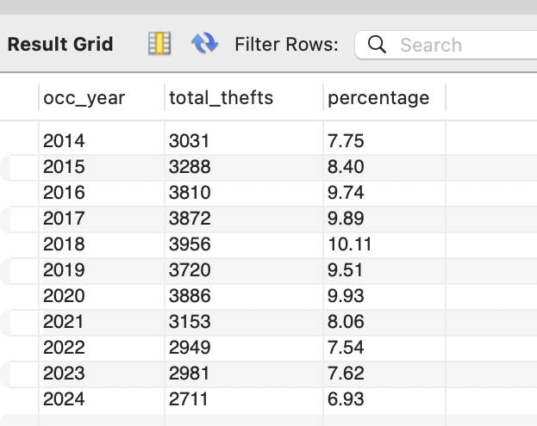
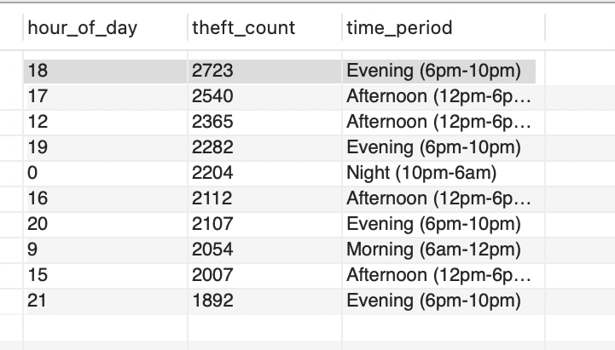
When Do Thefts Happen? - Temporal Analysis
SQL Query: Analyzed theft trends over time
Key Findings:
Peak Year: 2018 with 3,956 thefts
2024 Trend: Declining! Down 9.06% from 2023
Peak Month: July (5,996 thefts - summer cycling season)
Peak Hour: 6pm (2,723 thefts - evening commute)
Highest Risk Period: Evening (6pm-10pm)

Slide 25
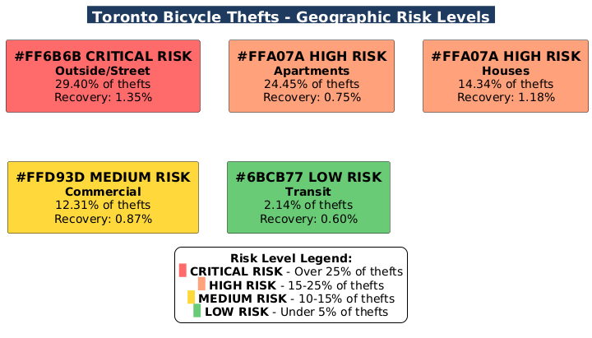
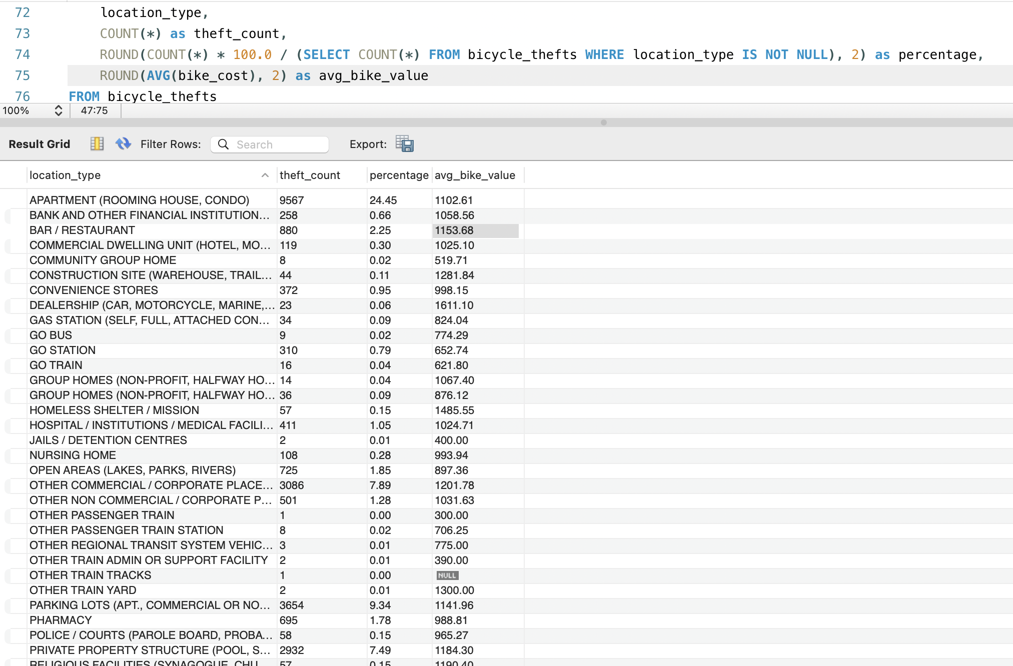
Where Do Thefts Happen? - Geographic Analysis
SQL Query: Analyzed theft locations and recovery rates
Key Findings:
Highest Risk: Outside/Street parking (29.40% of all thefts)
Second Highest: Apartments (24.45%)
Recovery Crisis: ALL locations show <2% recovery rate
Best Police Division: D31 with only 1.64% recovery
Worst Division: D32 with 0.59% recovery
Parking Lots: 9.34% of thefts - also high risk

Slide 26
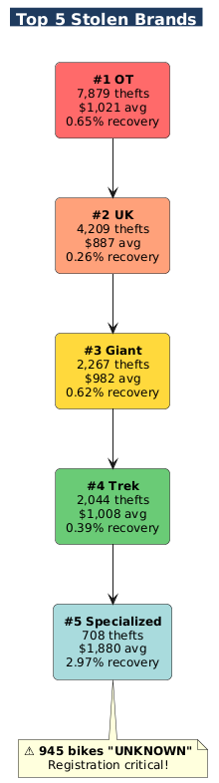
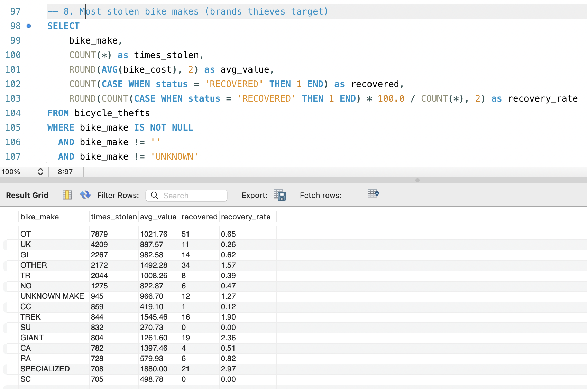
What Gets Stolen? - Bike Brand & Seasonal Analysis
SQL Query: Analyzed most stolen bike brands and seasonal patterns
Key Findings:
Bike Brands:
Most stolen: OT brand (7,879 thefts, avg value $1,021)
Second: UK brand (4,209 thefts, avg value $887)
Premium brands: Specialized ($1,880 avg) shows 2.97% recovery
945 bikes with "UNKNOWN" make - highlights registration need
Seasonal Patterns:
Summer (June-Aug): 16,894 thefts (43% of annual)
Winter (Dec-Feb): Only 3,229 thefts
6x higher risk in summer vs winter
Winter bikes: Higher average value ($1,300-$1,400)

Slide 27
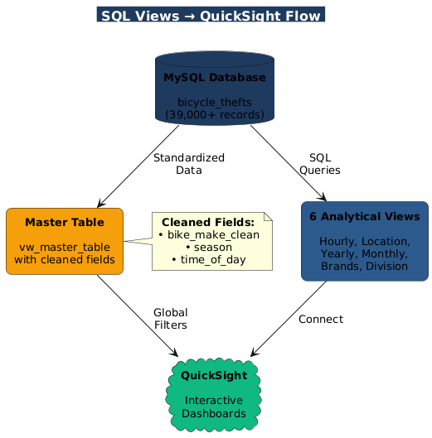
Data Products for Dashboards SQL Views & Master Table
SQL Views Created for QuickSight:
I built 6 analytical views to enable interactive dashboards:
vw_hourly_thefts - Time pattern analysis
vw_top_locations - Geographic hotspots with recovery rates
vw_yearly_trends - Year-over-year theft trends
vw_monthly_patterns - Seasonal analysis with bike values
vw_bike_brands - Brand targeting with recovery metrics
vw_division_performance - Police division performance
Master Table (vw_master_table):
Built for interactive filtering and global dashboards:
bike_make_clean - Standardized brand names (GIANT, TREK, etc.)
season - Winter/Spring/Summer/Fall classification
time_of_day - Morning/Afternoon/Evening/Night periods
Purpose: Enable Qi to create dynamic dashboards with filters

Slide 28
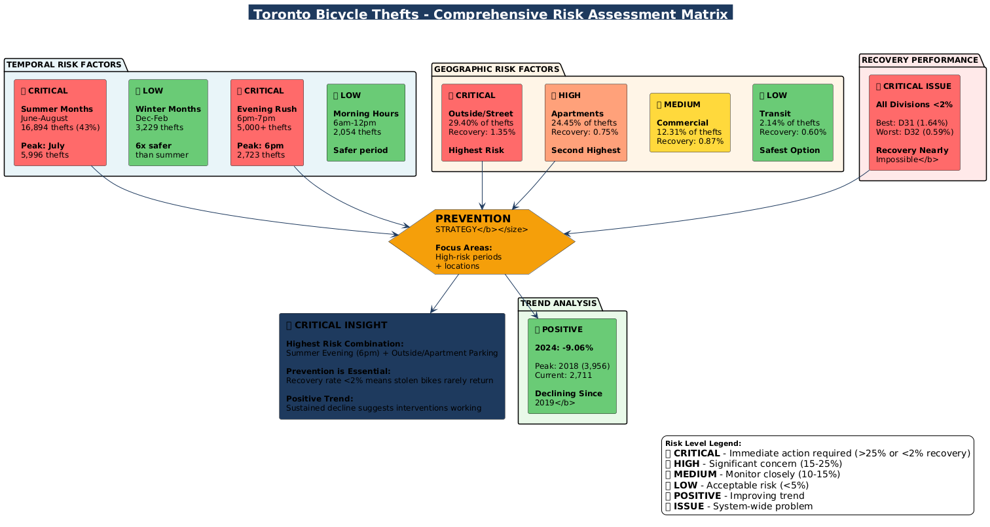

Slide 29
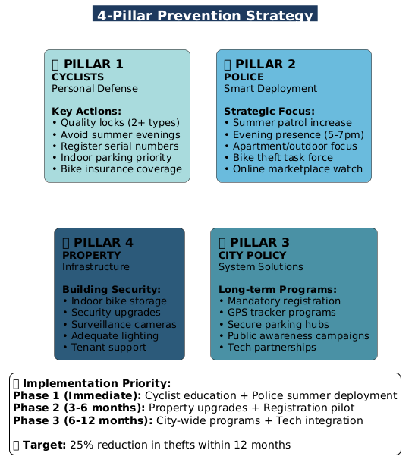
Recommendations & Action Plan
Why This Strategy Works:
Data-Driven Approach:
Analysis identified clear patterns in when, where, and what gets stolen
Each pillar targets a specific high-risk factor from our findings
Multi-Stakeholder Solution:
No single group can solve alone - requires coordinated effort
Addresses all risk dimensions: temporal, geographic, recovery
Proven Success Potential:
2024 shows 9.06% decline - interventions are working
Strategic focus can accelerate this positive trend
Prevention Over Recovery:
Current recovery rate: <2% across all divisions
Prevention is the only viable strategy
Coordinated approach maximizes impact

Slide 30
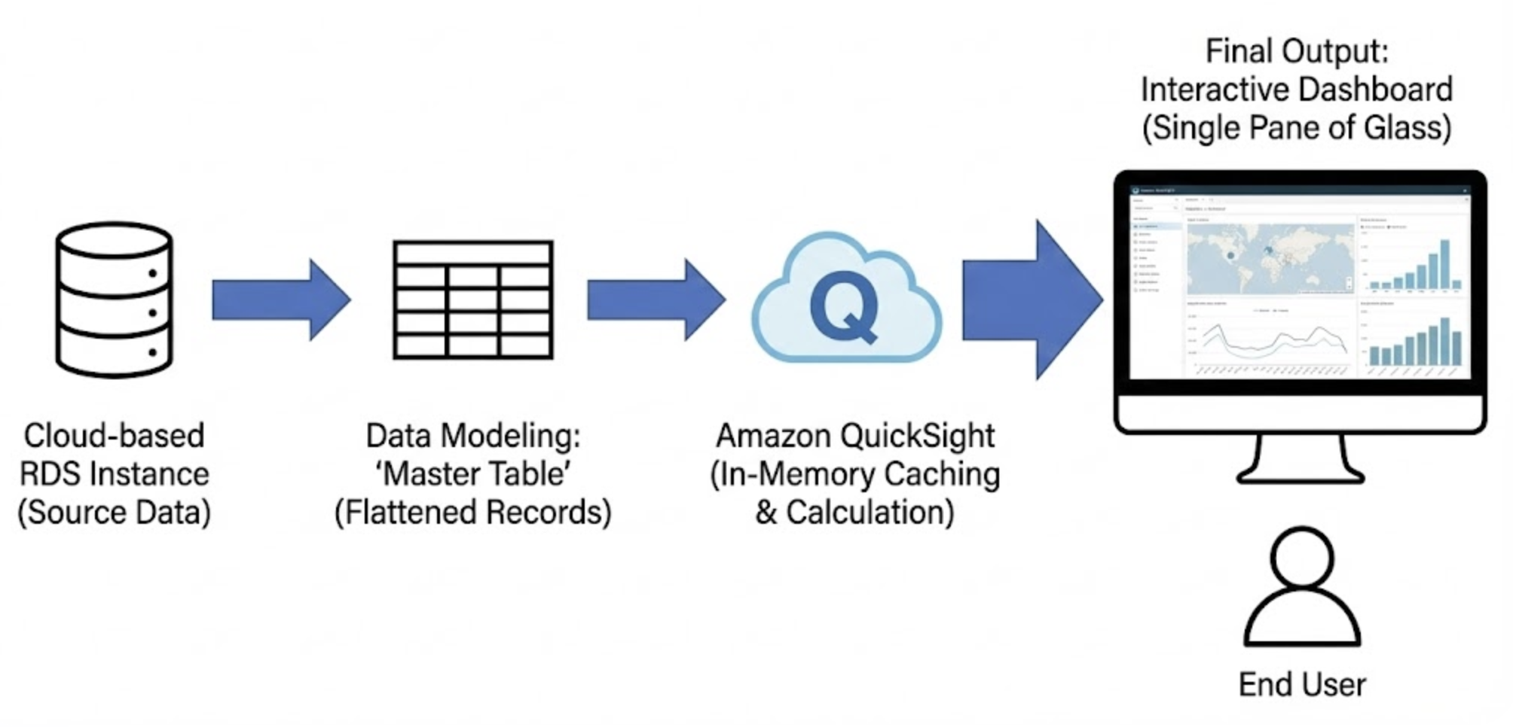
BI Implementation & Visual Analytics

Slide 31
Technical Architecture & Backend Strategy
BI Platform Selection: Amazon QuickSight (Cloud-native integration with RDS).
Data Modeling Strategy:
Moved from fragmented SQL views to a single "Master Table" architecture.
Enables dynamic aggregation and flexible filtering on the fly.
Performance Optimization (SPICE):
Utilized Super-fast, Parallel, In-memory Calculation Engine.
Result: Sub-second load times for 10+ years of geospatial data.

Slide 32
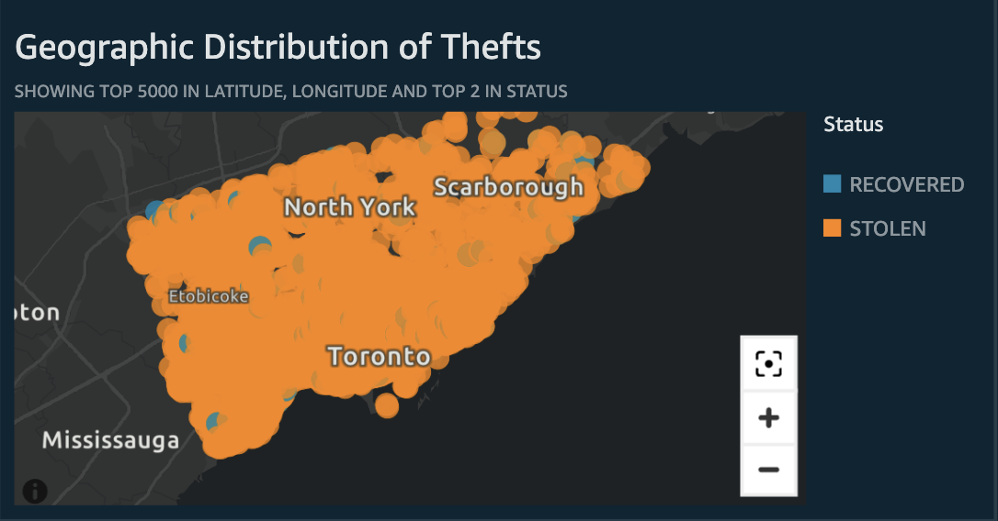
Visual Analysis – The "Where" and "When"
Spatial Analysis (The Map):
Visualization Type: Interactive Point Map (Pin-level Granularity).
Implementation: Plotted individual theft coordinates (Latitude/Longitude) to visualize exact incident locations rather than aggregated regions.
Insight Logic: Applied a conditional color schema (Orange = Stolen, Blue = Recovered), allowing users to identify precise "recovery hotspots" amidst the high-density theft zones.

Slide 33
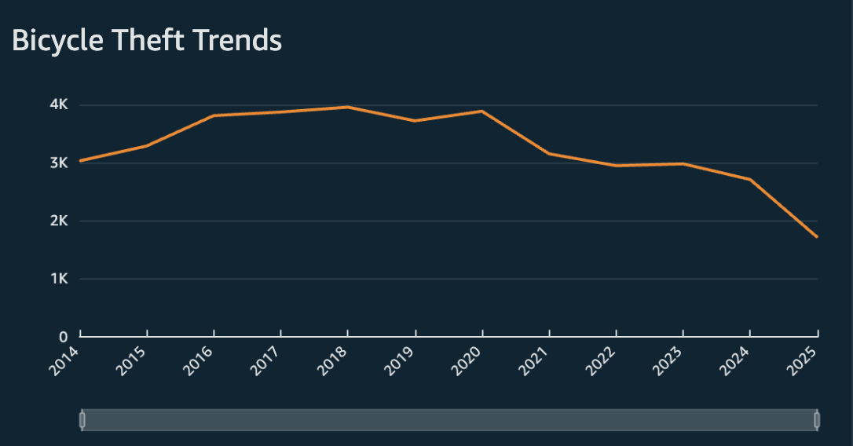
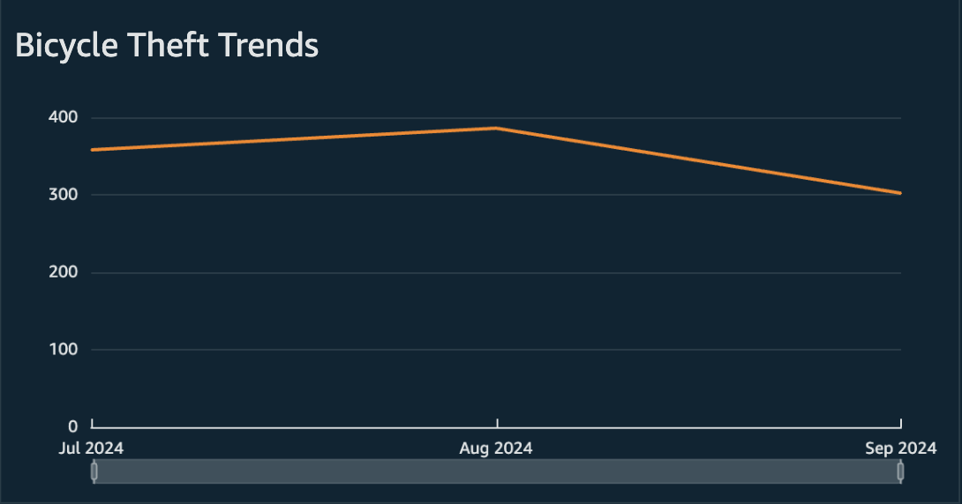
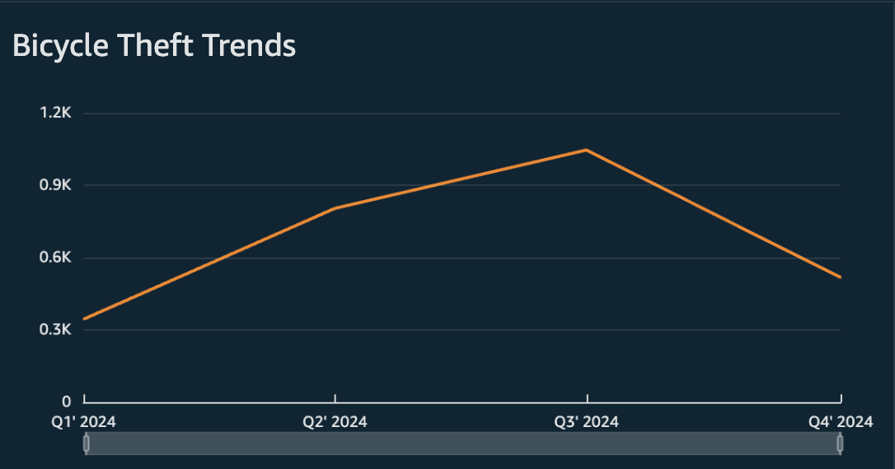
Visual Analysis – The "Where" and "When"
Temporal Analysis (The Trend):
Analysis Type: 10-Year Time Series tracking theft volume.
Interactive Feature: Implemented a Drill-Down Hierarchy (Year/Quarter/Month).
Why it matters: Allows users to switch between viewing long-term annual trends and investigating specific seasonal "waves" (Summer spikes) without changing the chart view.

Slide 34
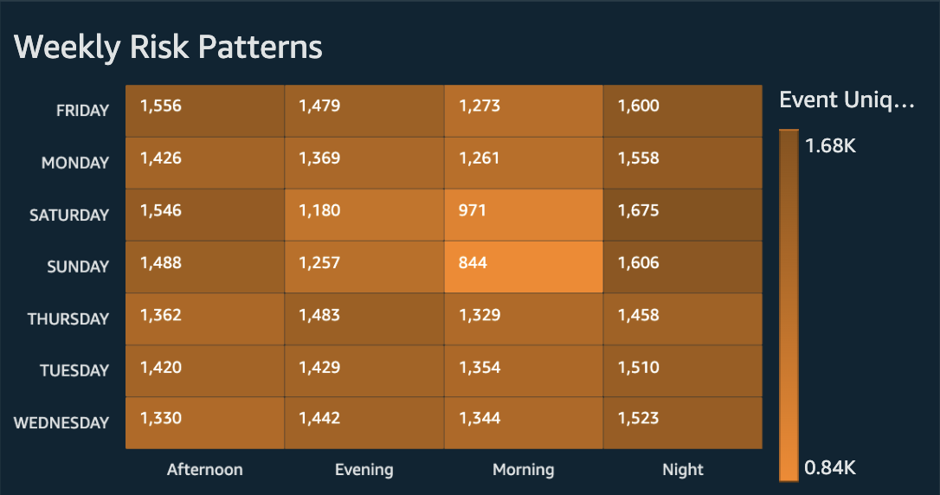
Behavioral Risk & Target Profiling
Behavioral Risk (The Heatmap):
Method: Matrix crossing Day of Week vs. Time of Day.
Discovery: Isolates "Danger Zones" (e.g., Friday Evenings) that simple line charts miss.

Slide 35
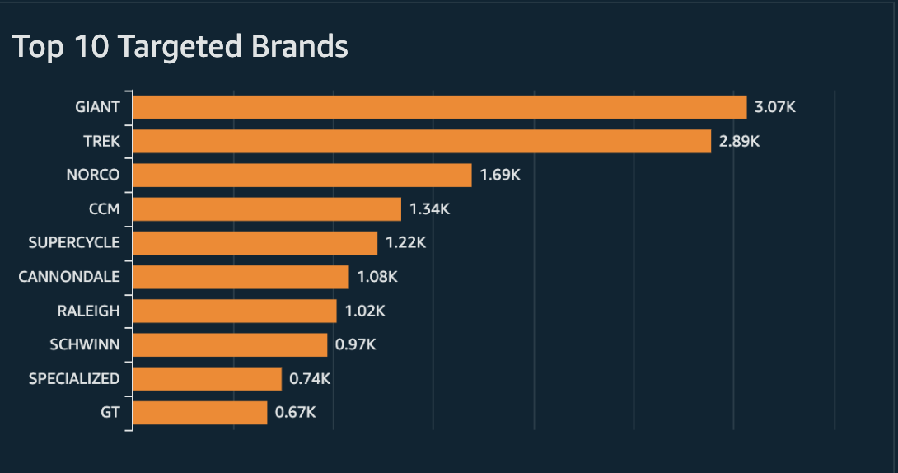
Behavioral Risk & Target Profiling
Target Analysis (The Bar Chart):
Method: Top 10 Ranking Filter on Bike_Make_Clean.
Constraint: Filtered "Unknown" data to focus on actionable insights.
Insight: Identifies premium brands (Giant, Trek) as primary targets for organized theft.

Slide 36
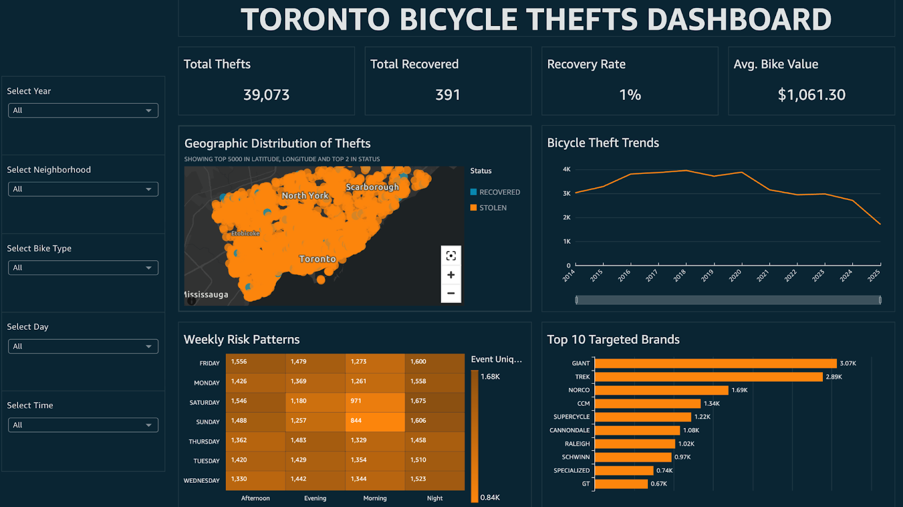
Dashboard Design & User Experience
"Single Pane of Glass" Architecture:
Implemented Free-form layout with auto-scaling ("Fit to Window"), ensuring the entire dashboard is visible without scrolling on any device.
Global Filter Suite:
Five interconnected controls (Year, Neighborhood, Bike Type, Day, Time) allow users to slice the entire dataset instantly.
Omni-Directional Interactivity:
Unified Action Layer: Interactivity is enabled on all components, including the 4 KPI Cards, Map, Trend Line, Heatmap, and Bar Chart.
Context-Aware Metrics: Clicking any visual (e.g., a map cluster) filters all other charts and instantly recalculates KPI totals to reflect the selected data.

Slide 37
Conclusion & Critical Insights
1. The Good News: Declining Trend
Bicycle thefts dropped over 9% in 2024, continuing a multi-year downward trajectory.
2. The Bad News: Recovery Crisis
The recovery rate remains extremely low at less than 2% across all police divisions.
3. High-Risk Locations
Apartments are the most vulnerable premises type, accounting for nearly 25% of all reported thefts.
4. "Danger Zones" (Time & Season)
Risk is not random. Summer months see 6x more thefts than winter, peaking specifically on July evenings.
5. Targeted Assets
Thieves are brand-aware. Premium brands like Giant and Trek are primary targets, while "Unknown" bikes still account for significant losses.

Slide 38
THANK YOU

